Slide 1
Project title – Instagram User Analytics
Project Description :-
This project is based on analysis done for the complete end to end operations of a company.
There were 2 case studies given 2 work upon. A brief description of both case studies and output required form both of them are given below :-
CASE STUDY 01 (JOB DATA)
Amount of jobs reviewed over time.
No. of events happening per second.
Share of each language for different contents.
Rows that have same values present in them.
CASE STUDY 02 (INVESTIGATING METRIC SPIKE)
To measure the activeness of a user.
Amount of users growing over time for a product.
Users getting retained weekly after signing up for a product.
To measure the activeness of a user weekly.
Users engaging with the email service.

Slide 2
Approach –
We have got datasets which contains many tables that contain information regarding various fields creating log of user activities. We went through the dataset closely and then executed various queries to extract the required data from the table.
Tech/Tools used –
We used below mentioned tools to perform the analysis :-
SQL - To run the Query and extract data from database.
PPT – To prepare a detailed report on the observations based on the data received.
EXCEL – Datasets received were in CSV format which were then imported to SQL via the import wizard.

Slide 3
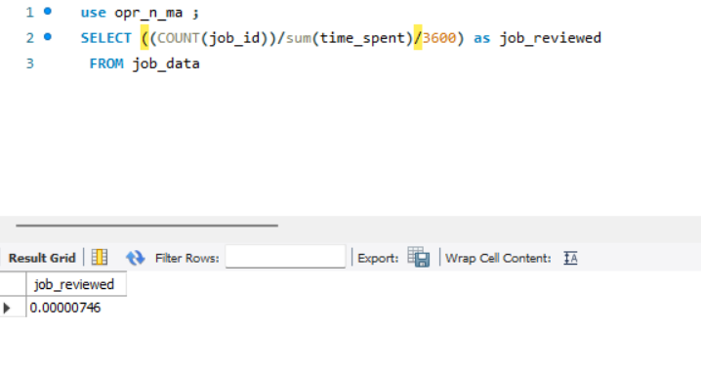
Insights –
We ran the query and recorded our observations based on the questions as asked by them in serial order.
1. Amount of jobs reviewed over time.

Slide 4
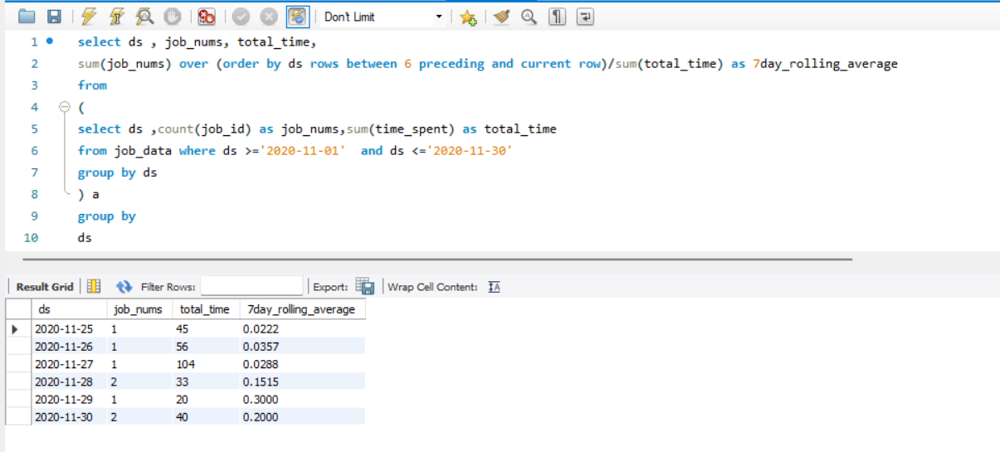
2. No. of events happening per second – to calculate 7 day rolling average.

Slide 5
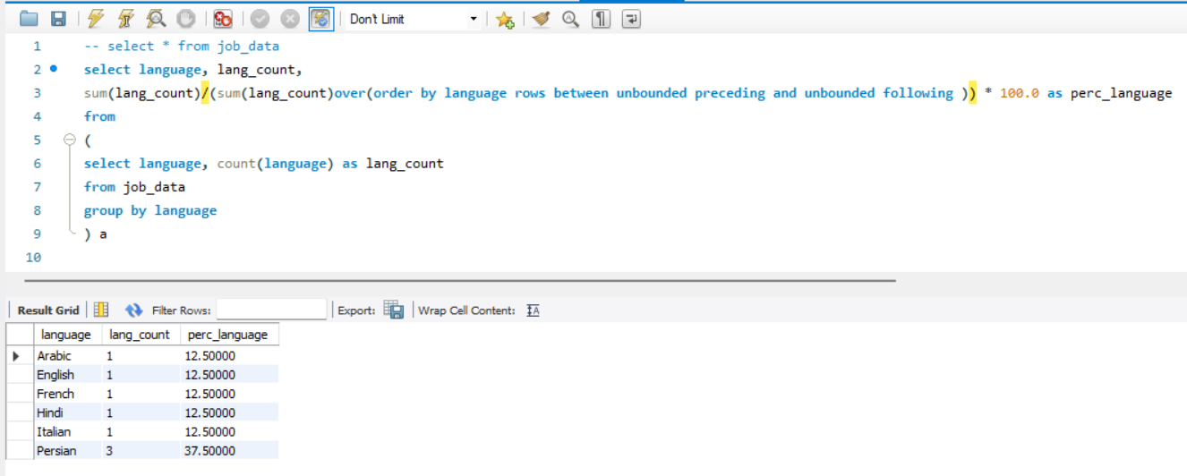
3. Share of each language for different contents.

Slide 6
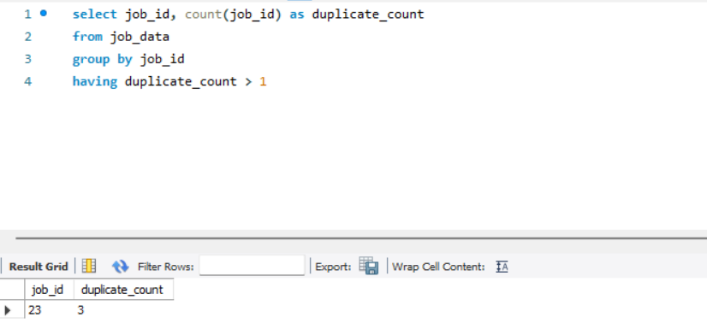
4. Rows that have same values present in them.

Slide 7
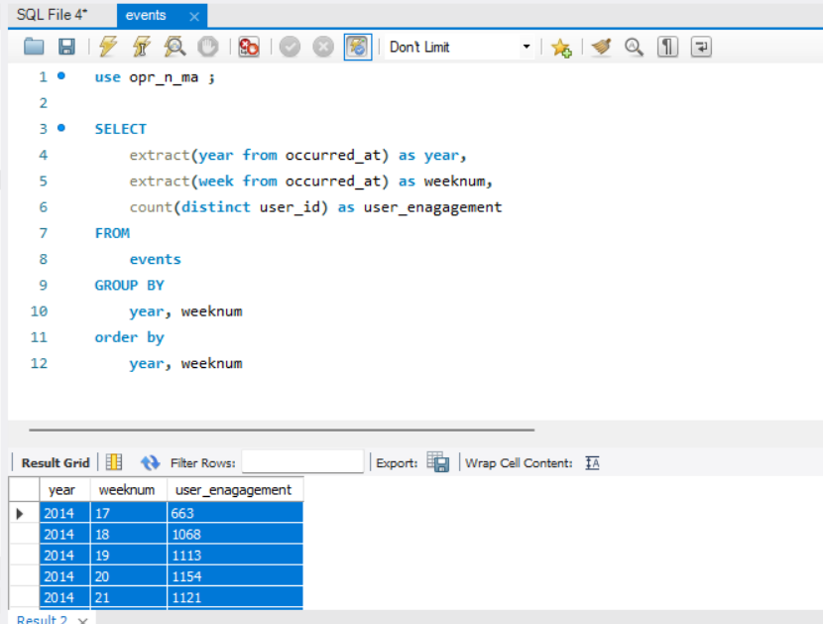
CASE STUDY 02 (INVESTIGATING METRIC SPIKE)
5. To measure the activeness of a user.

Slide 8
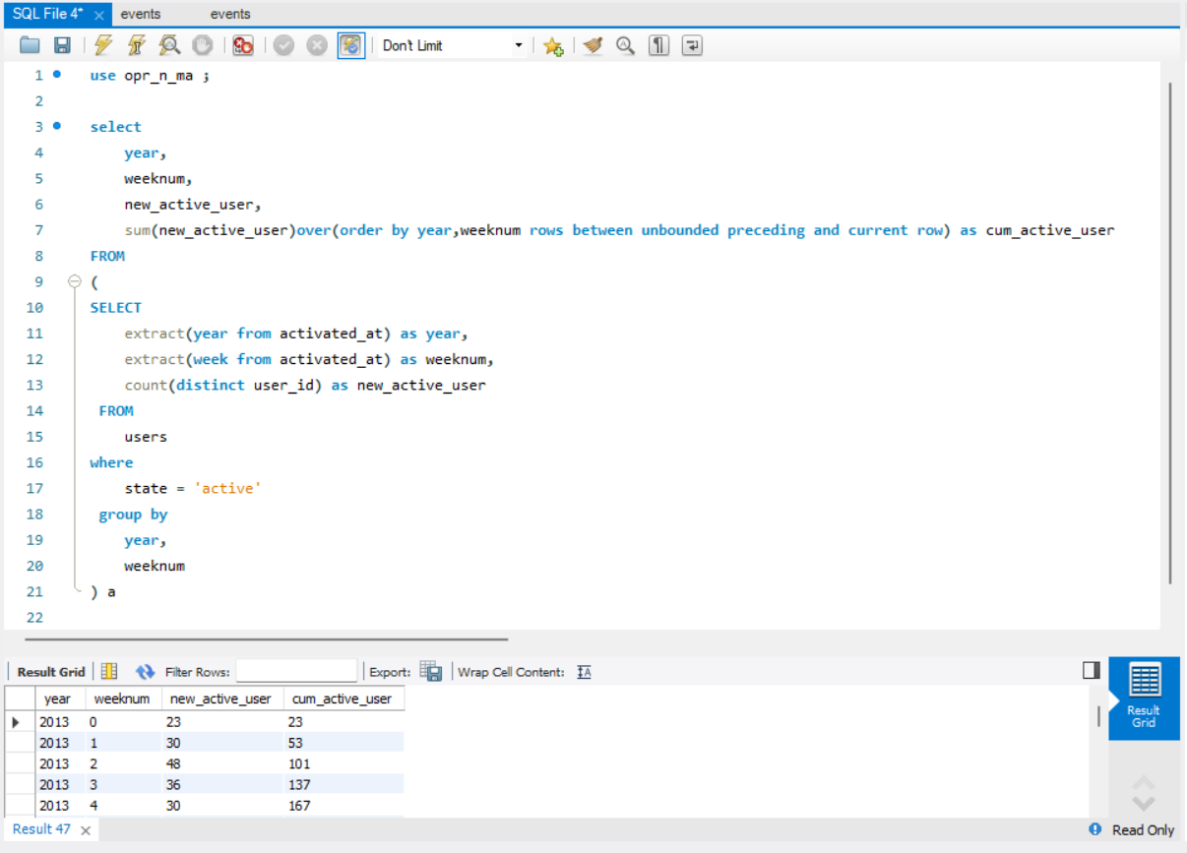
6. Amount of users growing over time for a product – number of active users per week.

Slide 9
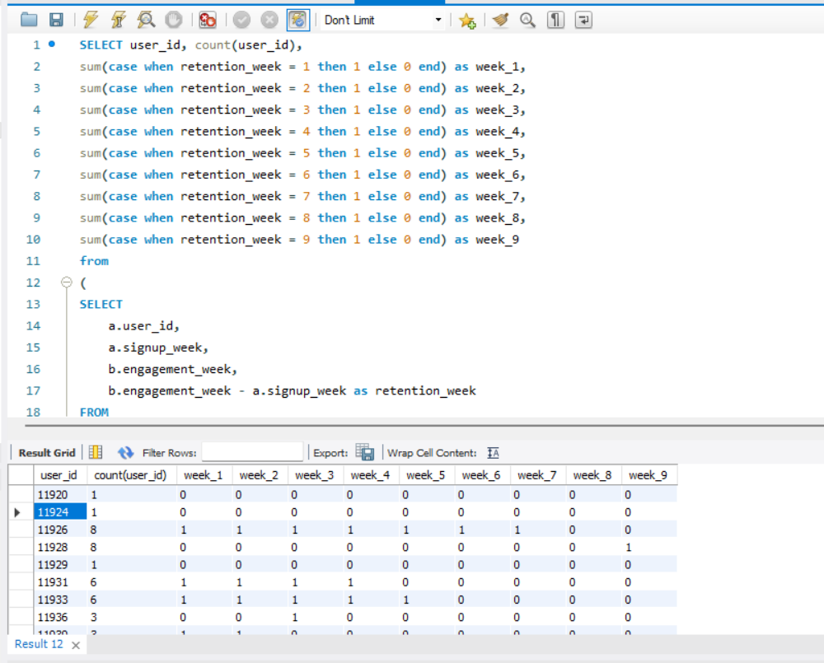
7. Users getting retained weekly after signing up for a product.

Slide 10
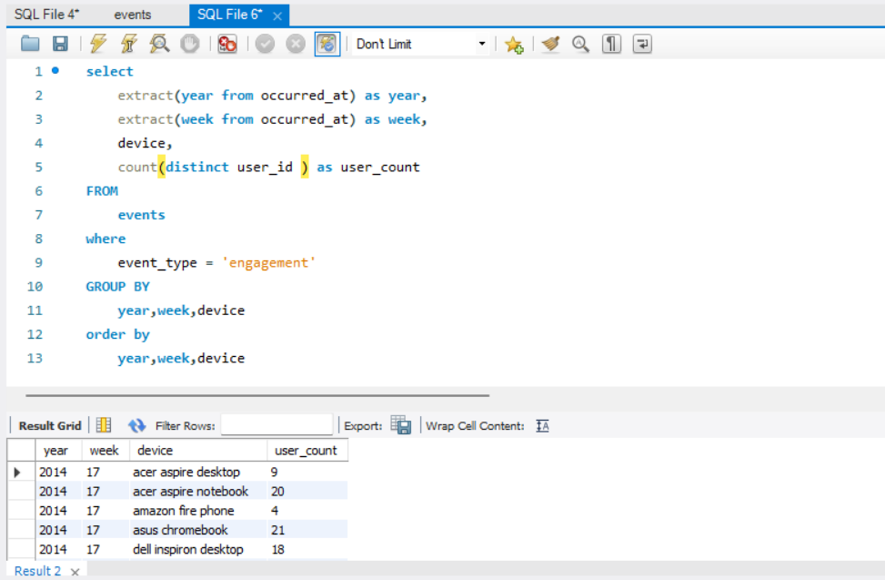
8. To measure the activeness of a user weekly - Calculate the weekly engagement per device.

Slide 11
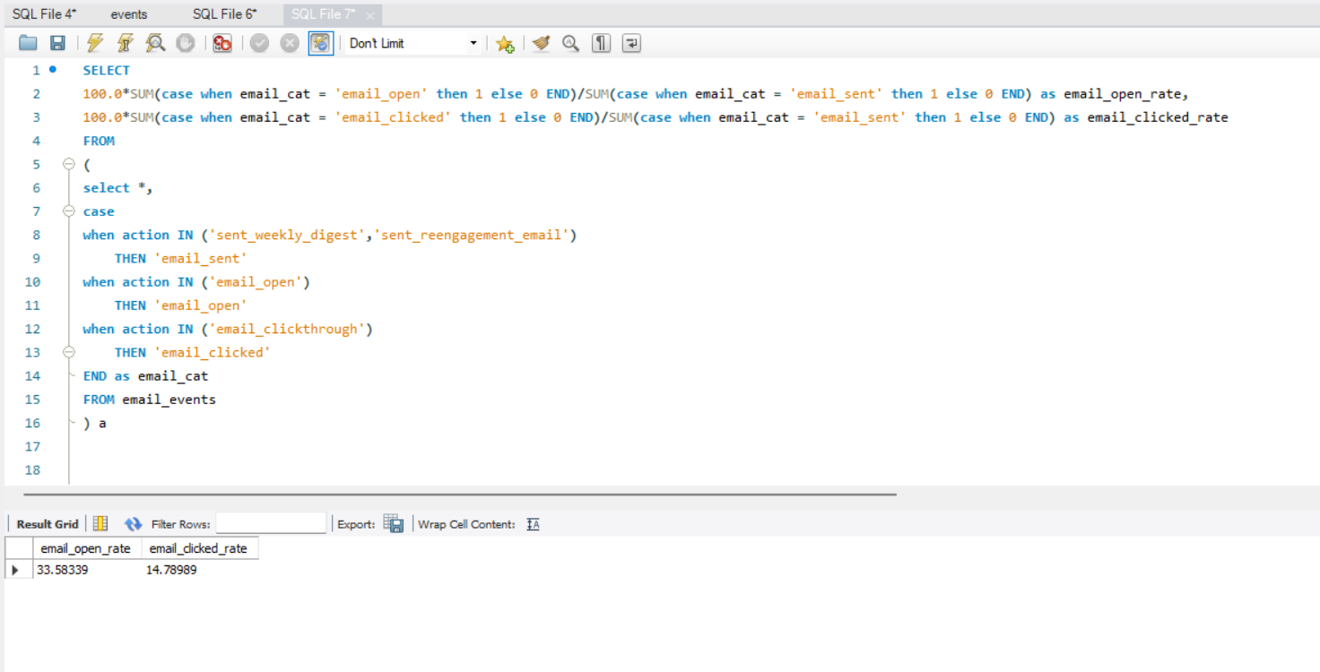
9. Users engaging with the email service.

Slide 12
RESULTS :-
All the results obtained are shown in screenshots in previous slides.
All complete values/data obtained after queries are present in excel attached below .

